Slide 1
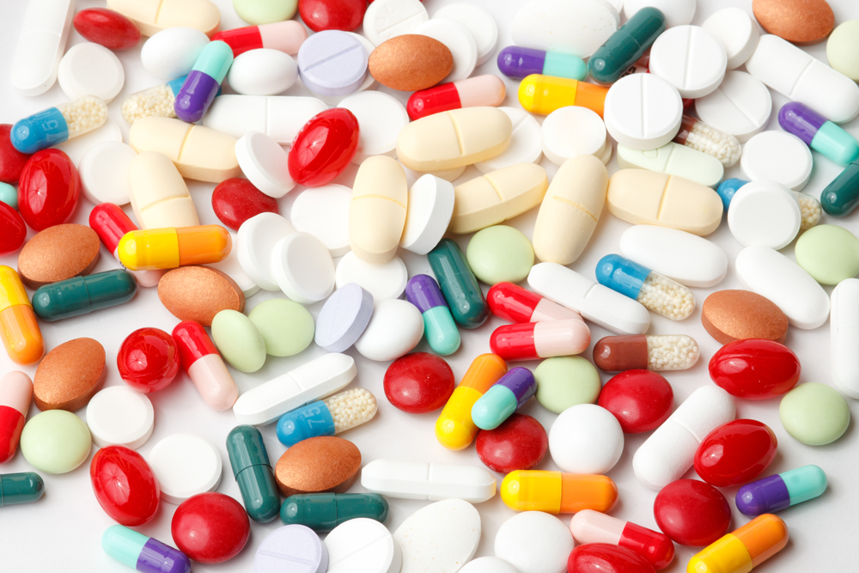
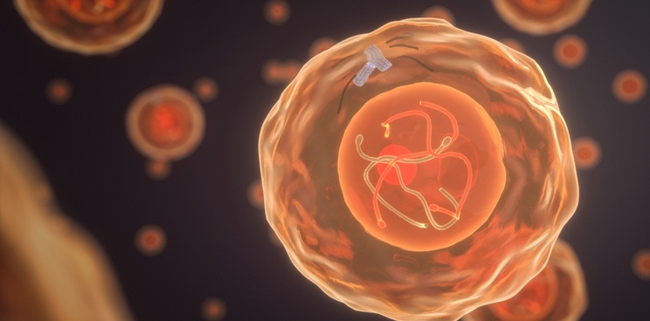
Prediction of Mechanism of Action of Drugs
Group Members
Parveen A & YUXIN DENG

Slide 2

Introduction
BACKGROUND
What is the Mechanism of Action (MoA) of a drug?
How do we determine the MoAs of a new drug?
OBJECTIVE
Develop algorithms and train models to determine the mechanism of action of a new drug based on the
gene expression and cell viability information.
INFORMATION
Human cell responses to drug within a pool of 100 cell types and 772 gene expressions.
206 MoA annotations of 5000+ drugs - each drug can have more than one MoA.

Slide 3
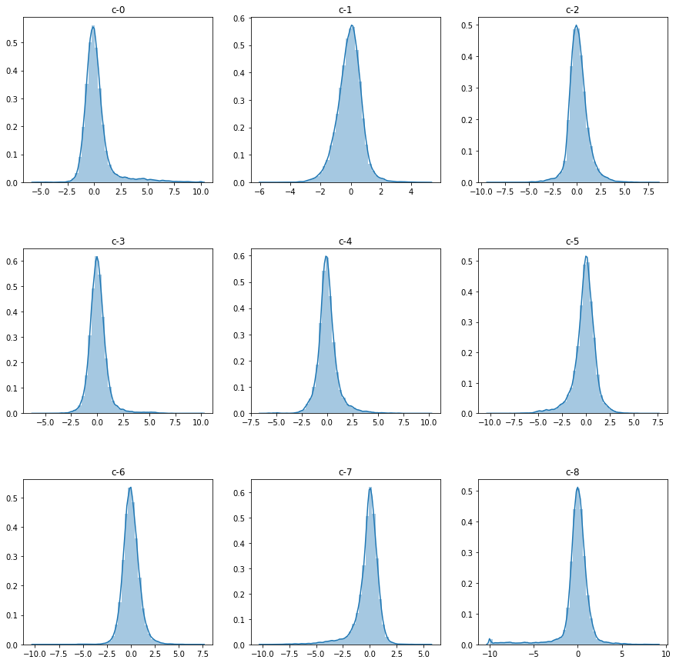
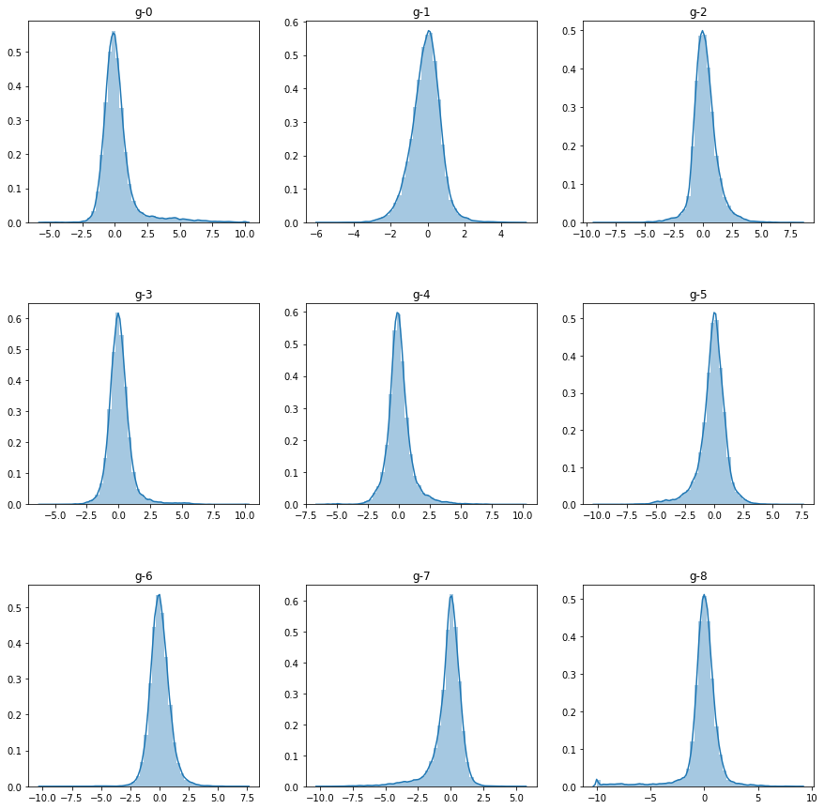
Data Overview
875 features are used to predict the target MoA
Features ‘g-’ : gene expression data(772)
Features ‘c-’ : cell viability data(100)
cp_type : samples treated with a compound or a control vehicle.
trt_cp samples treated with the compounds.
ctrl_vehicle samples treated with a control perturbation
cp_time : duration of treatment (24,48 and 72 hours).
cp_dose : the dosage given on a sample human cell (D1-low; D2-high).
Gene expressions and cell viability showing normal distribution

Slide 4
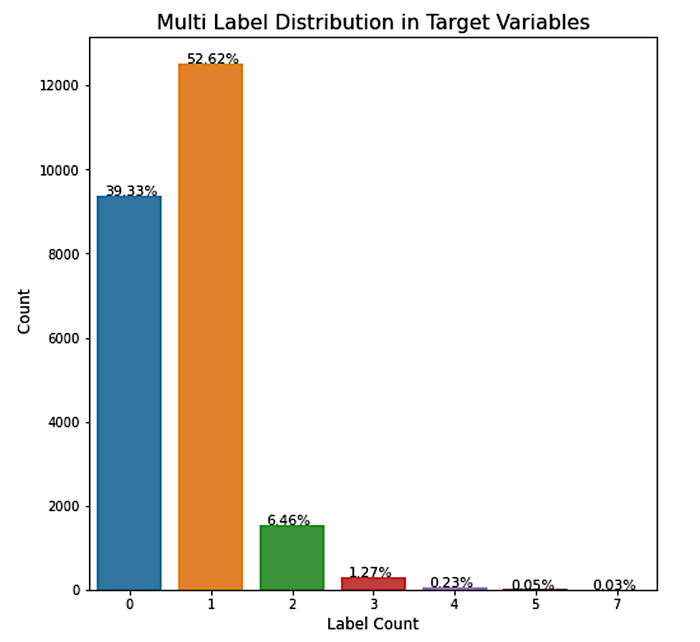
Data Overview
Feature Engineering on the Target Variable
206 target variables indicated via binary classification
‘0’ for no MoA , ‘1’ for one or more cells reacted
Each sample set is provided with a unique segment id so that we can combine the training features with the segment id present in the target data set.
Top target: from the bar plot we can see that nearly 40% of the drugs have no MoA whereas 53% have atleast one reaction. Rest 7% of the drugs have more than one MoA.

Slide 5
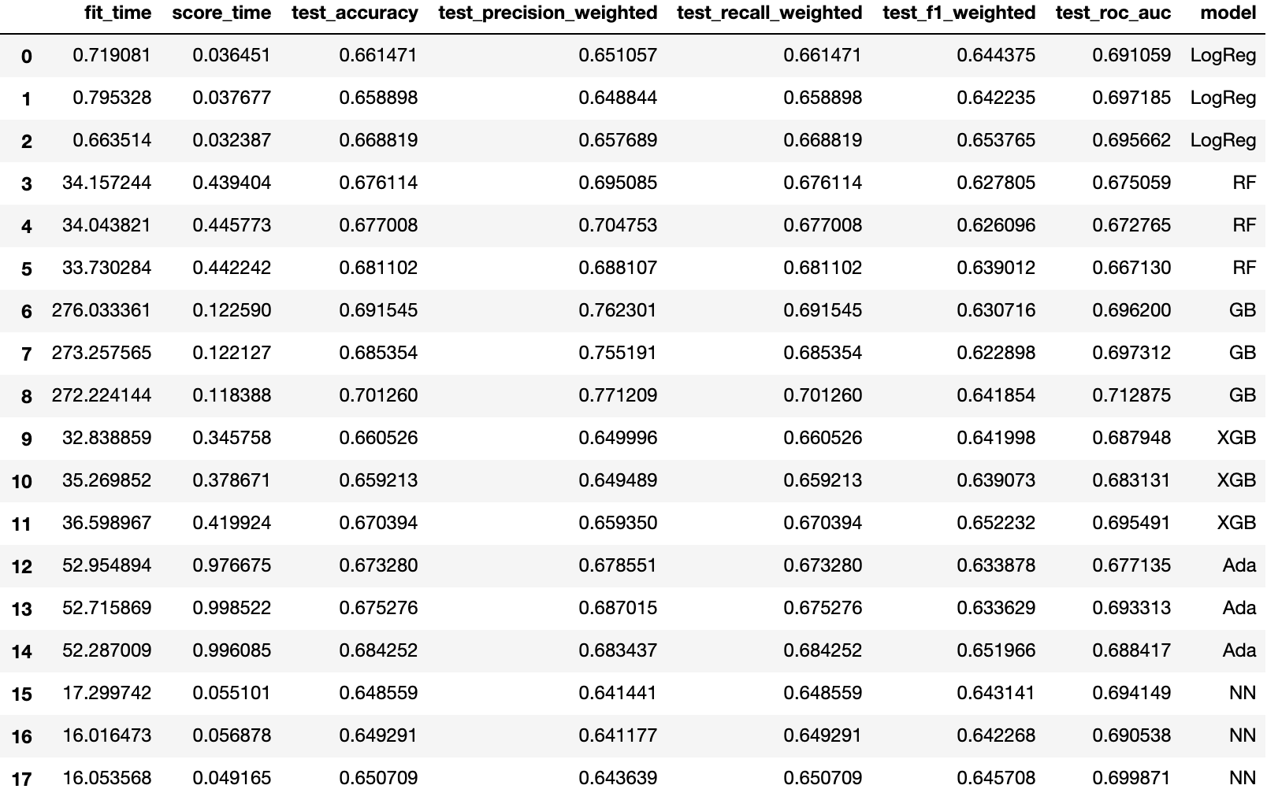
Model Selection
Six Classification Models:
Logistic Regression; XGBoost;
Random Forest; Gradient Boosting;
Adaptive Boosting; Neural Network
Method: kfolds cross validation
Package: sklearn.cross_validation
Function: cross_val_score
BOOM! Gradient Boosting Model got
highest accuracy with improved precision and recall score

Slide 6
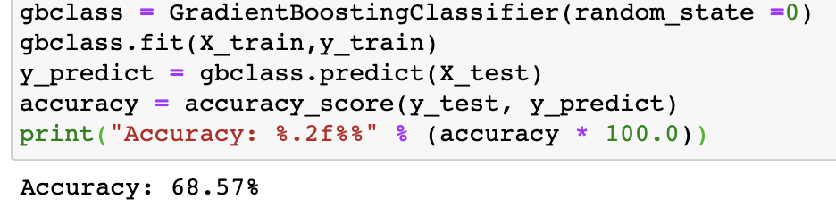
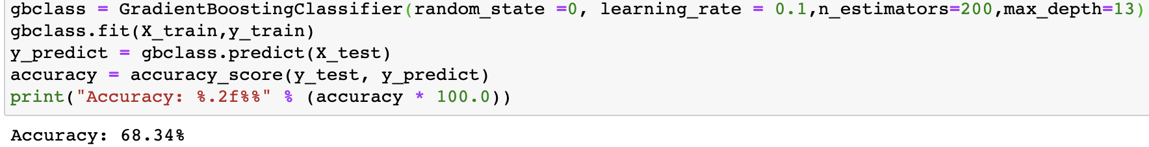
Parameter Tuning GBM
GBM with Default Parameter
Adjusting learning_rate & n_estimators
Adjusting max_depth
Adjusting min_samples_split

Slide 7
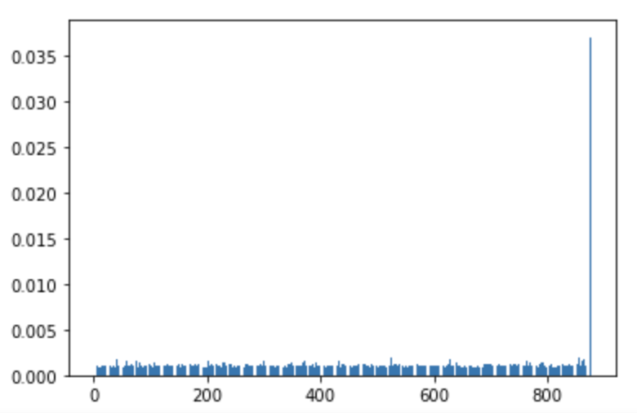
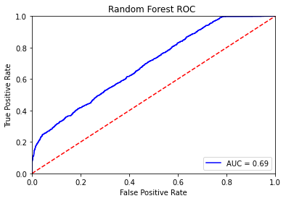
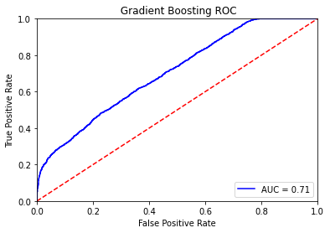
Feature Importance and ROC Curve
Top 5 Features
cp_type_trt_cp : 0.0370350693
g-385 : 0.005246530444261643
g-100 : 0.004499652065833654
g-175 : 0.002739617914478365
g-414 : 0.002585541811285111
Method: RandomForestClassifier()
cp_type_trt_cp: samples treated with a compound
Model Evaluation using ROC

Slide 8


Conclusion
Gradient Boosting Model
Sample treated with Compound to predict MoA of new drug
❔
Future: Better Model

Slide 9
References
Mechanism of action. Retrieved from https://en.wikipedia.org/wiki/Mechanism_of_action#:~:text=In%20pharmacology%2C%20the%20term%20mechanism,as%20an%20enzyme%20or%20receptor
Alison. L. (2008.05). Factors Affecting the Production of l-Phenylacetylcarbinol by Yeast: A Case Study. Retrieved form https://www.sciencedirect.com/science/article/abs/pii/S0065291108601642
Data Souse: Mechanisms of Action (MoA) Prediction. Retrieved from: https://www.kaggle.com/c/lish-moa

Slide 10
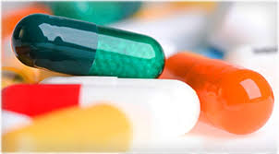


Slide 11


